Slide 1
City of Castroville
Stormwater Master Plan – Public Meeting #2 Project Update
August 30, 2022

Slide 2
Overview
PROJECT GOALS
Flood risk planning and communication
Promote transparency and buy-in
Assist with project funding
Project Implementation
Invests in community needs

Slide 3
Overview
TODAY’S OBJECTIVES
Receive input on scoring priorities
Discuss conceptual project solutions

Slide 4
What is more important?
PUBLIC SAFETY
Structural flooding
Roadway flooding
Emergency access
Frequency of damages
Erosion hazards
PUBLIC SAFETY IS __________________ THAN ECONOMICS.
MORE IMPORTANT | EQUALLY IMPORTANT | LESS IMPORTANT
ECONOMICS
Project cost
Funding availability
Enhances development/ redevelopment potential
Notes:
Old Notes: Waterfall work flow diagram?
Key Considerations
Hydrology led by AECOM; 3 teams for Hydraulics to be performed simultaneously
Mitigation Projects - example of UBC Flood Study thru implementation (Ruth, Monica)
How to mitigate schedule risks? Identify critical paths and methods
Highlight team capacity and redundancy

Slide 5
What is more important?
PUBLIC SAFETY
Structural flooding
Roadway flooding
Emergency access
Frequency of damages
Erosion hazards
PUBLIC SAFETY IS __________________ THAN THE TIMING.
TIMING
(How quickly can the project be implemented)
PERMITTING LENGTH
LAND/EASEMENT NEEDS
Project Readiness
Project dependencies
MORE IMPORTANT | EQUALLY IMPORTANT | LESS IMPORTANT
Notes:
Old Notes: Waterfall work flow diagram?
Key Considerations
Hydrology led by AECOM; 3 teams for Hydraulics to be performed simultaneously
Mitigation Projects - example of UBC Flood Study thru implementation (Ruth, Monica)
How to mitigate schedule risks? Identify critical paths and methods
Highlight team capacity and redundancy

Slide 6
What is more important?
PUBLIC SAFETY
Structural flooding
Roadway flooding
Emergency access
Frequency of damages
Erosion hazards
PUBLIC SAFETY IS __________________ THAN THE ENVIRONMENTAL IMPACTS.
ENVIRONMENT
IMPACTS TO HABITATS, NATURAL WATERWAYS, TREES, WETLANDS
WATER QUALITY BENEFITS
MORE IMPORTANT | EQUALLY IMPORTANT | LESS IMPORTANT
Notes:
Old Notes: Waterfall work flow diagram?
Key Considerations
Hydrology led by AECOM; 3 teams for Hydraulics to be performed simultaneously
Mitigation Projects - example of UBC Flood Study thru implementation (Ruth, Monica)
How to mitigate schedule risks? Identify critical paths and methods
Highlight team capacity and redundancy

Slide 7
What is more important?
ECONOMICS
Project cost
Funding availability
Enhances development/ redevelopment potential
ECONOMICS IS __________________ THAN PROJECT TIMING.
TIMING
(How quickly can the project be implemented)
PERMITTING LENGTH
LAND/EASEMENT NEEDS
Project Readiness
Project dependencies
MORE IMPORTANT | EQUALLY IMPORTANT | LESS IMPORTANT
Notes:
Old Notes: Waterfall work flow diagram?
Key Considerations
Hydrology led by AECOM; 3 teams for Hydraulics to be performed simultaneously
Mitigation Projects - example of UBC Flood Study thru implementation (Ruth, Monica)
How to mitigate schedule risks? Identify critical paths and methods
Highlight team capacity and redundancy

Slide 8
What is more important?
ECONOMICS
Project cost
Funding availability
Enhances development/ redevelopment potential
ECONOMICS IS __________________ THAN THE ENVIRONMENTAL IMPACTS.
ENVIRONMENT
IMPACTS TO HABITATS, NATURAL WATERWAYS, TREES, WETLANDS
WATER QUALITY BENEFITS
MORE IMPORTANT | EQUALLY IMPORTANT | LESS IMPORTANT
Notes:
Old Notes: Waterfall work flow diagram?
Key Considerations
Hydrology led by AECOM; 3 teams for Hydraulics to be performed simultaneously
Mitigation Projects - example of UBC Flood Study thru implementation (Ruth, Monica)
How to mitigate schedule risks? Identify critical paths and methods
Highlight team capacity and redundancy

Slide 9
What is more important?
TIMING
(How quickly can the project be implemented)
PERMITTING LENGTH
LAND/EASEMENT NEEDS
Project Readiness
Project dependencies
PROJECT TIMING IS __________________ THAN THE ENVIRONMENTAL IMPACTS.
ENVIRONMENT
IMPACTS TO HABITATS, NATURAL WATERWAYS, TREES, WETLANDS
WATER QUALITY BENEFITS
MORE IMPORTANT | EQUALLY IMPORTANT | LESS IMPORTANT
Notes:
Old Notes: Waterfall work flow diagram?
Key Considerations
Hydrology led by AECOM; 3 teams for Hydraulics to be performed simultaneously
Mitigation Projects - example of UBC Flood Study thru implementation (Ruth, Monica)
How to mitigate schedule risks? Identify critical paths and methods
Highlight team capacity and redundancy

Slide 10
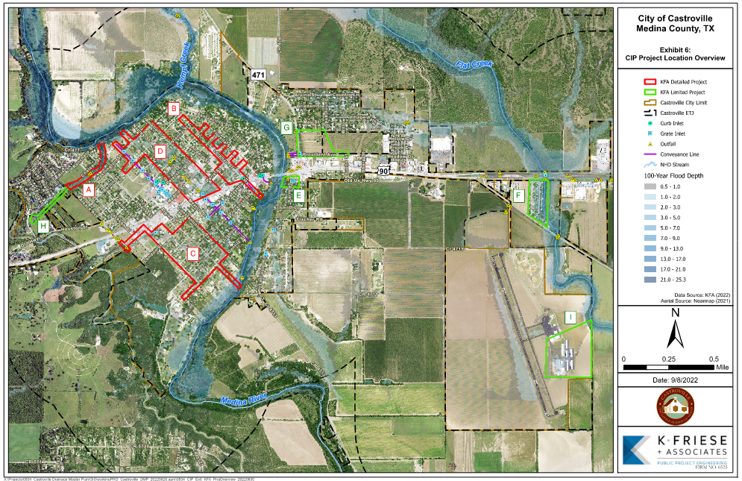
PROJECT LIST
Garcia Creek Channel Stabilization
North Lorenzo Street
S. Athens / S. Algiers Street
N. Naples Street
Lower LaCoste Road / Karm Street
Valley Mobile Home Park
Provident Avenue
River Valley Road
Castroville Airport Channel Erosion
Notes:
Old Notes: Waterfall work flow diagram?
Key Considerations
Hydrology led by AECOM; 3 teams for Hydraulics to be performed simultaneously
Mitigation Projects - example of UBC Flood Study thru implementation (Ruth, Monica)
How to mitigate schedule risks? Identify critical paths and methods
Highlight team capacity and redundancy

Slide 11
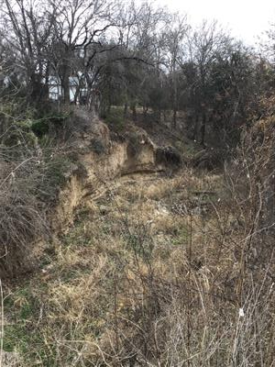
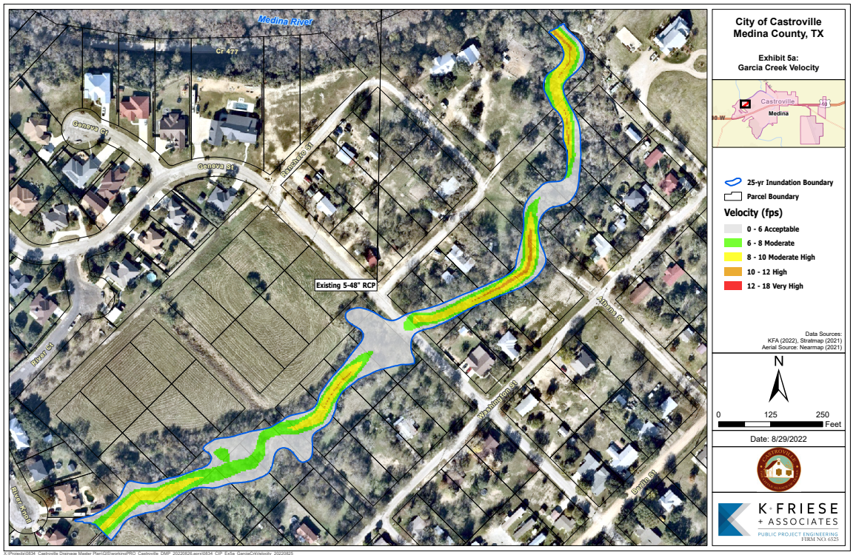
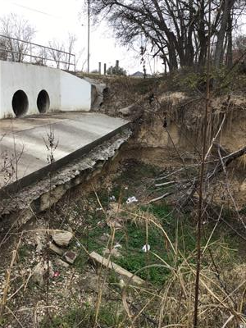
Garcia Creek Channel Stabilization
KEY ISSUES: Accelerated erosion and stability issues placing Geneva Street Culvert at risk, loss of property (real estate, structures)
SOLUTION: Reconstruct downstream concrete apron at Geneva, construct stilling basins/ grade control drop structures, armoring of channel banks.
COST & BENEFITS:
Protection level: 25-year
Cost Range: $0.7M to $1M
Benefits: Prevent erosion from encroaching onto existing properties and undercutting Geneva Street.
Bank Erosion
Erosion undercutting structure
Notes:
Old Notes: Waterfall work flow diagram?
Key Considerations
Hydrology led by AECOM; 3 teams for Hydraulics to be performed simultaneously
Mitigation Projects - example of UBC Flood Study thru implementation (Ruth, Monica)
How to mitigate schedule risks? Identify critical paths and methods
Highlight team capacity and redundancy

Slide 12
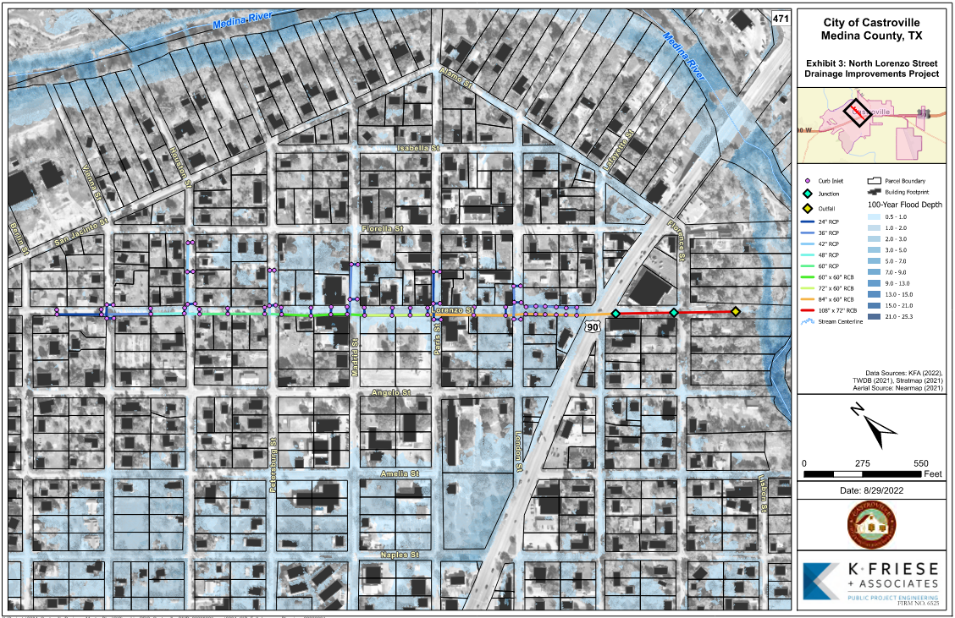
North Lorenzo Street
KEY ISSUES: Roadway, property, and structural flooding due to insufficient existing storm sewer and ditch capacity.
SOLUTION: Storm drain and inlet system, full-depth roadway reconstruction (curb & gutter) on Lorenzo.
COST & BENEFITS:
Protection level: 100-year
Cost Range: $8M-12M
Benefits: Reduce flood risk to 25+ residential structures, improve public safety
Notes:
Old Notes: Waterfall work flow diagram?
Key Considerations
Hydrology led by AECOM; 3 teams for Hydraulics to be performed simultaneously
Mitigation Projects - example of UBC Flood Study thru implementation (Ruth, Monica)
How to mitigate schedule risks? Identify critical paths and methods
Highlight team capacity and redundancy

Slide 13
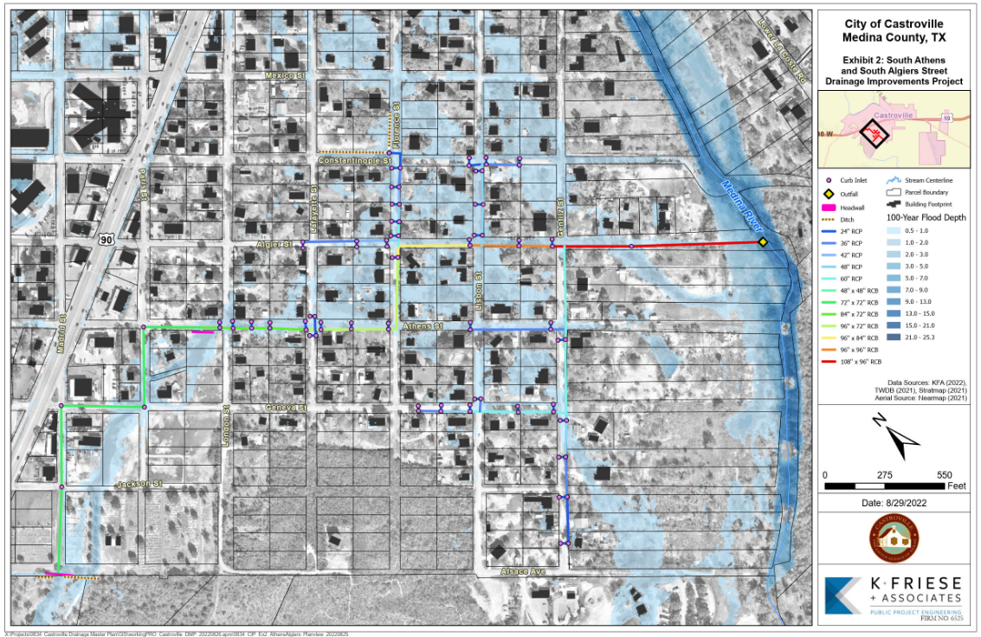
S. Athens / S. Algiers Streets
KEY ISSUES: Roadway, property, and structural flooding due to insufficient existing storm sewer and ditch capacity.
SOLUTION: Storm drain and inlet system, full-depth roadway reconstruction (curb & gutter) on Athens, Algiers, Gentilz
COST & BENEFITS:
Protection level: 100-year
Cost Range:
Phase 1: $11M-$15M
Phase 2: $3M-$4M
Benefits: Reduce flood risk to 30+ residential structures, improve public safety.
Phase 1
Phase 2
Notes:
Old Notes: Waterfall work flow diagram?
Key Considerations
Hydrology led by AECOM; 3 teams for Hydraulics to be performed simultaneously
Mitigation Projects - example of UBC Flood Study thru implementation (Ruth, Monica)
How to mitigate schedule risks? Identify critical paths and methods
Highlight team capacity and redundancy

Slide 14
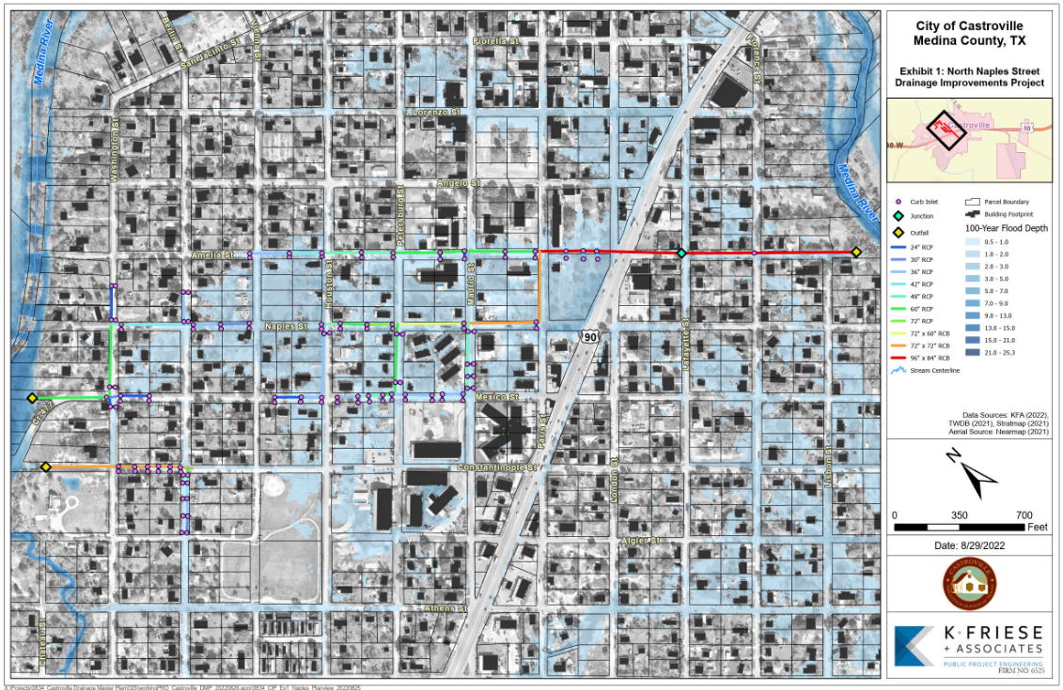
N. Naples Street
KEY ISSUES: Roadway, property, and structural flooding due to insufficient existing storm sewer and ditch capacity.
SOLUTION: Storm drain and inlet system, full-depth roadway reconstruction (curb & gutter) on portions of Naples, Amelia, Mexico, and Constantinople.
COST & BENEFITS:
Protection level: 100-year
Cost Range:
Phase 1: $12M-$15M
Phase 2: $4M-$5M
Phase 3: $3M-$4M
Benefits: Reduce flood risk to 30+ residential structures, improve public safety.
Phase 1
Phase 2
Phase 3
Notes:
Old Notes: Waterfall work flow diagram?
Key Considerations
Hydrology led by AECOM; 3 teams for Hydraulics to be performed simultaneously
Mitigation Projects - example of UBC Flood Study thru implementation (Ruth, Monica)
How to mitigate schedule risks? Identify critical paths and methods
Highlight team capacity and redundancy

Slide 15

Schedule
What’re the major milestones?
May – Select projects for evaluation
Public meeting for buy-in on issues and projects
June – City coordination
Finalize list of projects to be evaluated
City staff meeting to discuss criteria, codes, report outline, solutions
August – Present CIP project solutions and feedback
City staff meeting and coordination
Public meeting #2
September – Draft Report
Review and comment
October/November – Final Report
Finalize, council presentation and adoption

